Slide 1
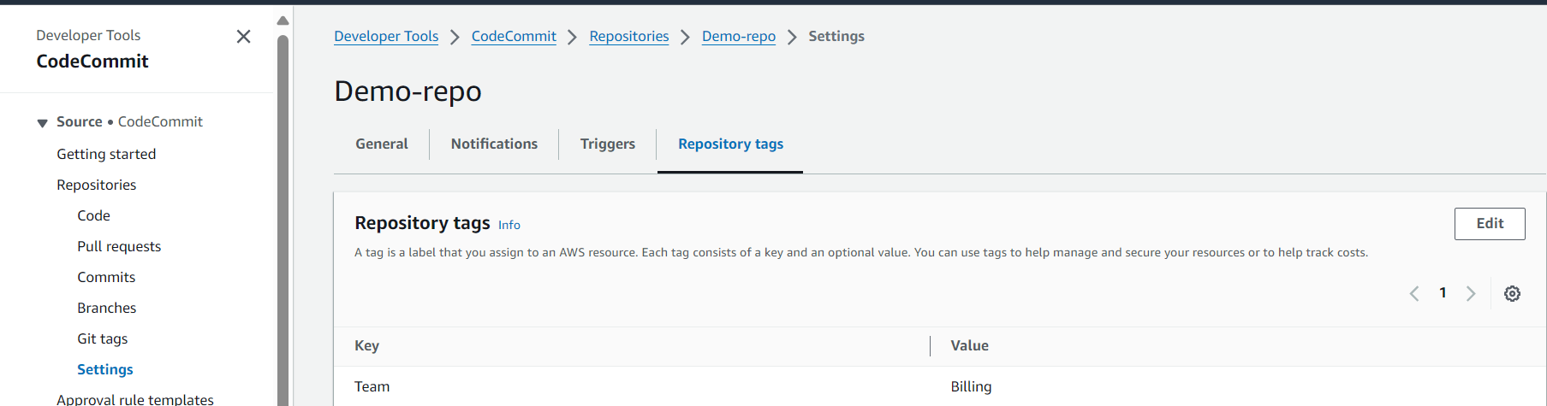
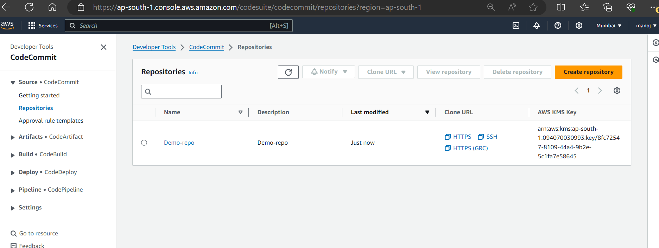
AWS Code Commit – Git Repositories as service
AWS Code commit is a managed source control service which is used for hosting Git repos.
Repositories tags.
Repositories can be tagged in AWS code commit which further helps in below points.
Organization: Tags help in organizing repositories into logical groups.
Search and Filtering: Easily search and filter repositories based on tags.
Cost Allocation: Use tags to allocate costs to different projects or departments.
Access Management: Apply policies based on tags to manage access to repositories.

Slide 2
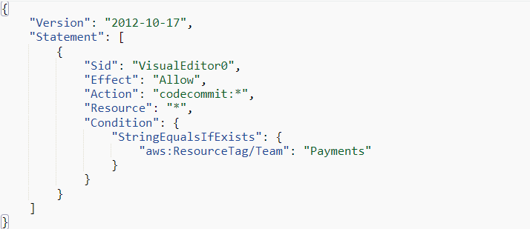
Identity policies based on tags
We can create policies which allows and denies actions on repositories based on AWS tags associated with those repositories .
Ex: lets assume there are 20 developers they are part of team → billings , so what we want is those 20 developers should have access to their set of repositories .
To do this 1st we need to tag the repositories that is team → billings and then we need create a IAM policy.

Slide 3
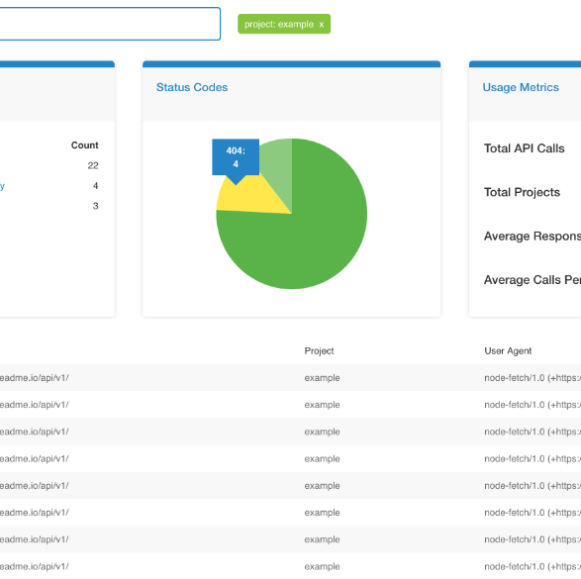
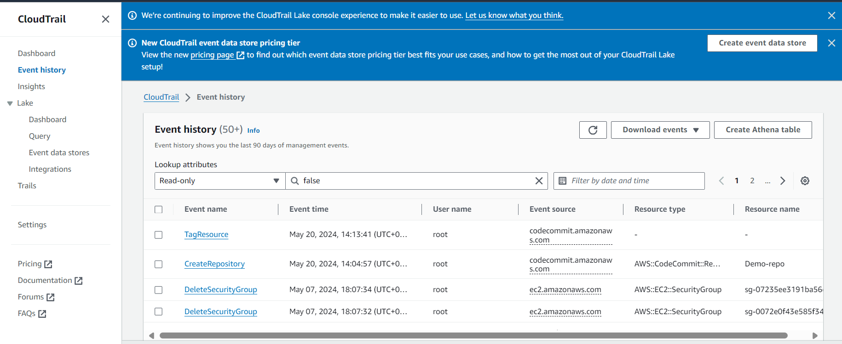
Code Commit integrates with AWS services
AWS code commit integrates with various services like lambda , events bridge , cloud trail, code build , AWS KMS etc .
Logging Code commit API calls.
AWS code commit is integrated with cloud Trail that allows Administrators to capture insights into activities by users .

Slide 4
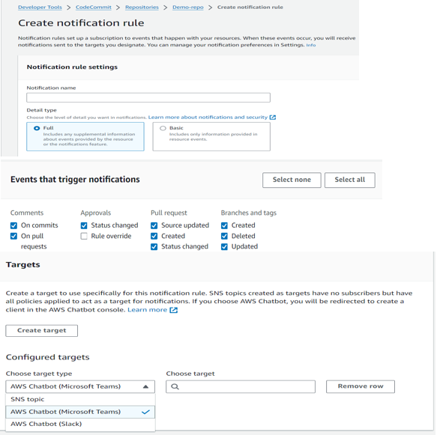
Notification Rules
We can set up a notification rules for a repository so that repository users receive emails about the repositories events types we specify .
Notifications are sent when events match the notification rule settings .

Slide 5
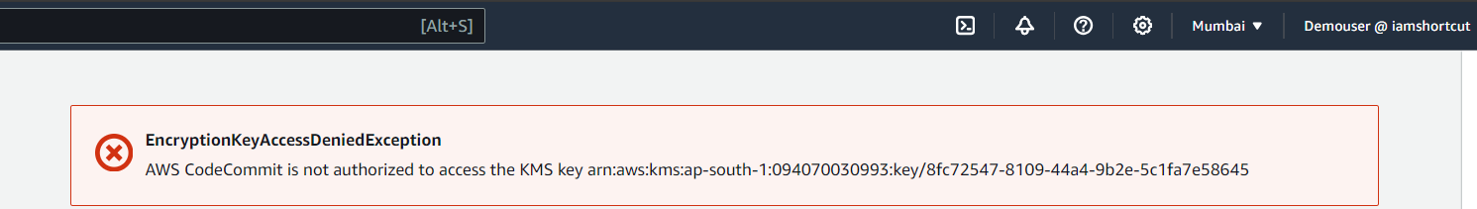
Data Protection
Data in Code commit repositories is encrypted in transit and rest it means when the data is pushed into a code commit repositories (for example by calling git push ) , code commit encrypts the received data and when the data is pulled from a Code commit repositories (For example by calling git pull ) Code commit decrypts the data and then send it to the caller .
Data sent or received is transmitted using HTTPS or SSH encrypted network protocols.

Slide 6
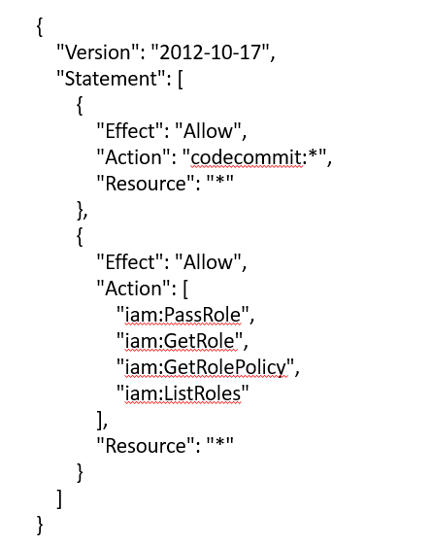
Identity policy for AWS Code Commit
There is mainly 3 types of policies for code commit .
1 . AWSCodeCommitFullAccess.
2. AWSCodeCommitReadOnly.
3. AWSCodeCommitPowerUser.
AWSCodeCommitFullAccess.
Description: Grants full access to all CodeCommit resources and operations.
Use Case: Suitable for administrators who need full control over CodeCommit repositories.
Permissions: Includes actions such as creating, deleting, and updating repositories, as well as managing branch and file operations.

Slide 7
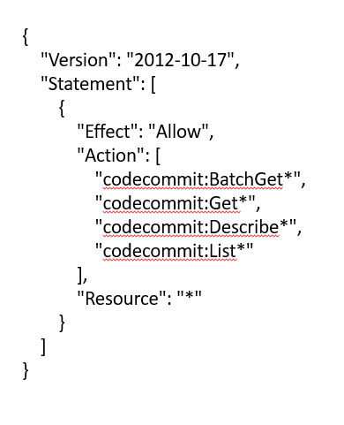
Identity policy for AWS Code Commit
2. AWSCodeCommitReadOnly.
Description: Provides read-only access to CodeCommit repositories.
Use Case: Ideal for users who need to view repositories and download content but do not need to make changes.
Permissions: Allows actions such as viewing repositories, branches, and commits, but not creating, updating, or deleting repositories.

Slide 8
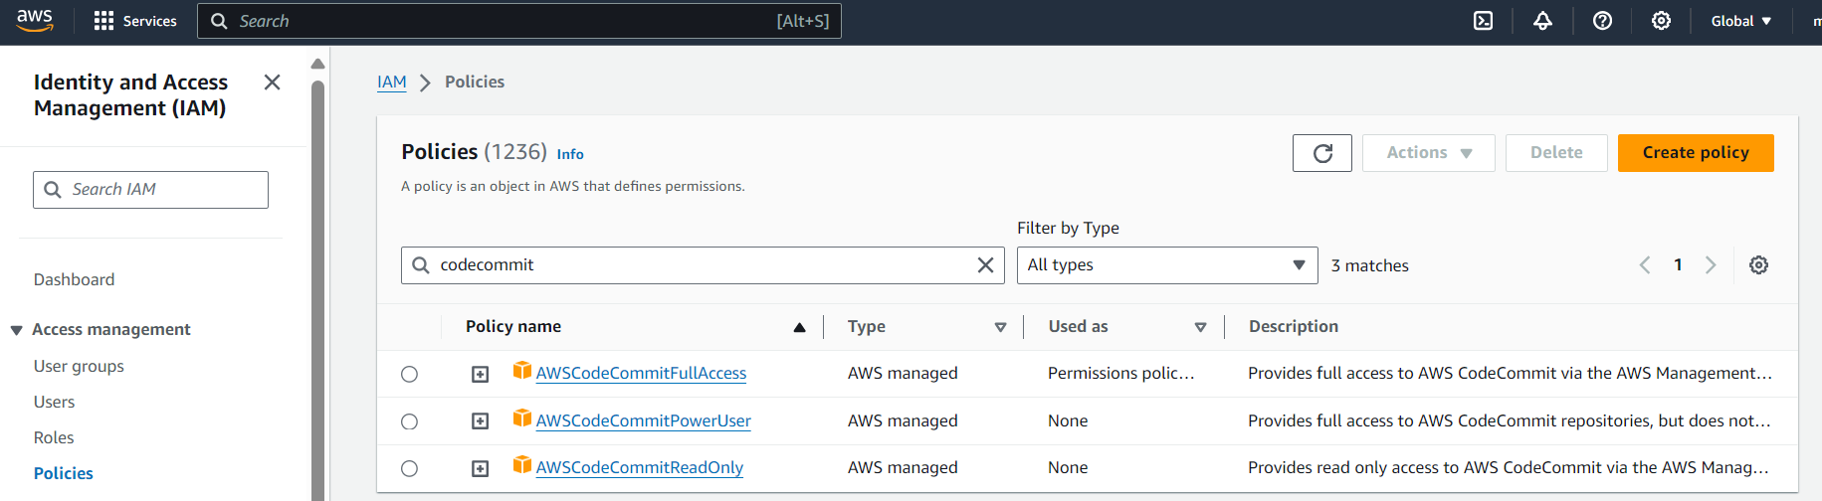
Identity policy for AWS Code Commit
3. AWSCodeCommitPowerUser.
Description: Grants broad access to CodeCommit resources and operations, but does not include full administrative privileges.
Use Case: Suitable for power users who need extensive permissions but not full administrative control.
Permissions: Includes most actions except for some administrative operations.

Slide 9
AWSCodeCommitPowerUser.
{
"Version": "2012-10-17",
"Statement": [
{
"Effect": "Allow",
"Action": [
"codecommit:AssociateApprovalRuleTemplateWithRepository",
"codecommit:BatchAssociateApprovalRuleTemplateWithRepositories",
"codecommit:BatchDescribeMergeConflicts",
"codecommit:BatchDisassociateApprovalRuleTemplateFromRepositories",
"codecommit:BatchGetCommits",
"codecommit:BatchGetRepositories",
"codecommit:CreateBranch",
"codecommit:CreateCommit",
"codecommit:CreatePullRequest",
"codecommit:CreateRepository",
"codecommit:DeleteBranch",
"codecommit:DeleteFile",
"codecommit:DeletePullRequestApprovalRule",
"codecommit:DeleteRepository",
"codecommit:DescribeMergeConflicts",
"codecommit:DescribePullRequestEvents",
"codecommit:DisassociateApprovalRuleTemplateFromRepository",
"codecommit:GetBlob",
"codecommit:GetBranch",
"codecommit:GetComment",
"codecommit:GetCommentsForComparedCommit",
"codecommit:GetCommentsForPullRequest",
"codecommit:GetCommit",
"codecommit:GetDifferences",
"codecommit:GetFile",
"codecommit:GetFolder",
"codecommit:GetMergeCommit",
"codecommit:GetMergeConflicts",
"codecommit:GetMergeOptions",
"codecommit:GetPullRequest",
"codecommit:GetRepository",
"codecommit:GetRepositoryTriggers",
"codecommit:ListApprovalRuleTemplates",
"codecommit:ListAssociatedApprovalRuleTemplatesForRepository",
"codecommit:ListBranches",
"codecommit:ListPullRequests",
"codecommit:ListRepositories",
"codecommit:MergeBranchesByFastForward",
"codecommit:MergeBranchesBySquash",
"codecommit:MergeBranchesByThreeWay",
"codecommit:OverridePullRequestApprovalRules",
"codecommit:PostCommentForComparedCommit",
"codecommit:PostCommentForPullRequest",
"codecommit:PostCommentReply",
"codecommit:PutFile",
"codecommit:PutRepositoryTriggers",
"codecommit:TestRepositoryTriggers",
"codecommit:UpdateComment",
"codecommit:UpdateDefaultBranch",
"codecommit:UpdatePullRequestApprovalRuleContent",
"codecommit:UpdatePullRequestApprovalState",
"codecommit:UpdatePullRequestDescription",
"codecommit:UpdatePullRequestStatus",
"codecommit:UpdatePullRequestTitle",
"codecommit:UpdateRepositoryDescription",
"codecommit:UpdateRepositoryName"
],
"Resource": "*"
}
]
}

Slide 10
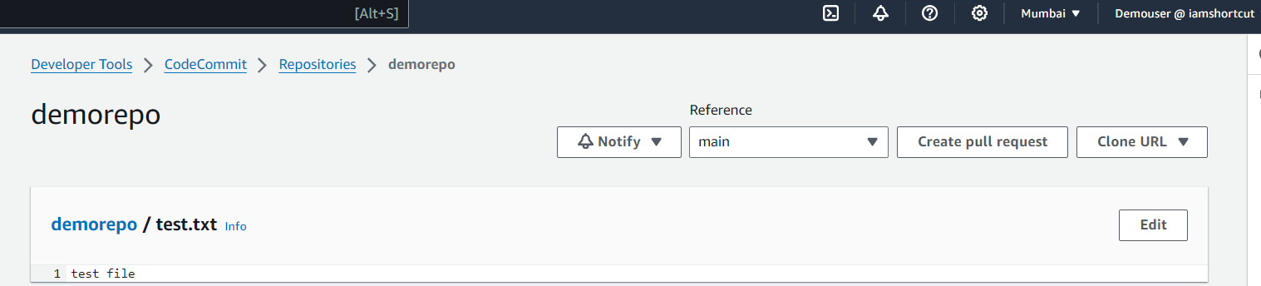
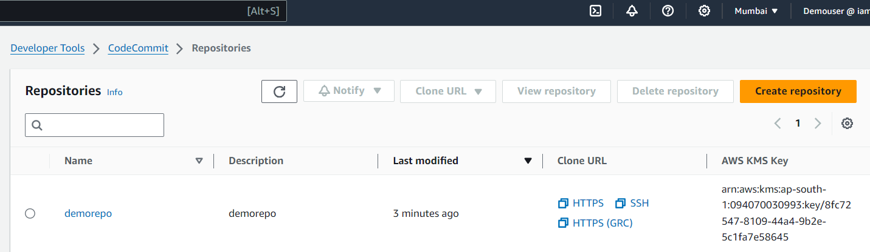
KMS
As we discussed earlier Data in Code commit repositories is encrypted in transit and rest it means when the data is pushed into a code commit repositories (for example by calling git push ) , code commit encrypts the received data and when the data is pulled from a Code commit repositories (For example by calling git pull ) Code commit decrypts the data and then send it to the caller .
It is important to ensure that there is no explicit deny added for KMS in the policy associated with the users otherwise Code Commit operations wont work.
Labs:
Without KMS . create a user give aws code commit full access to the user (AWSCodeCommitFullAccess) .
Now in root account create a repo in code commit and add a file and verify if that user is able to access that file or not , yes the user can able to access the file and repo.

Slide 11
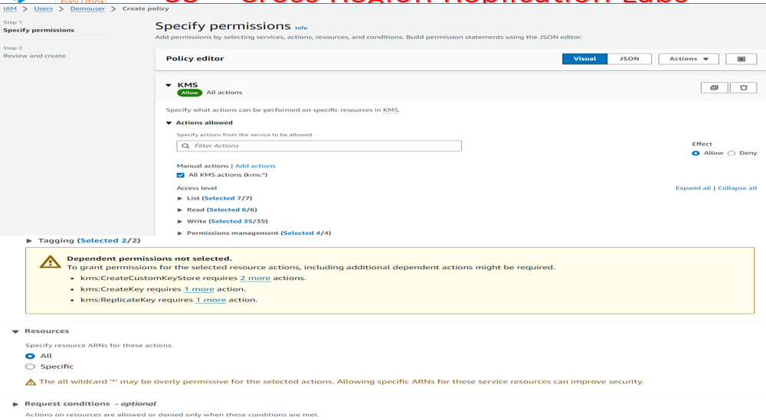
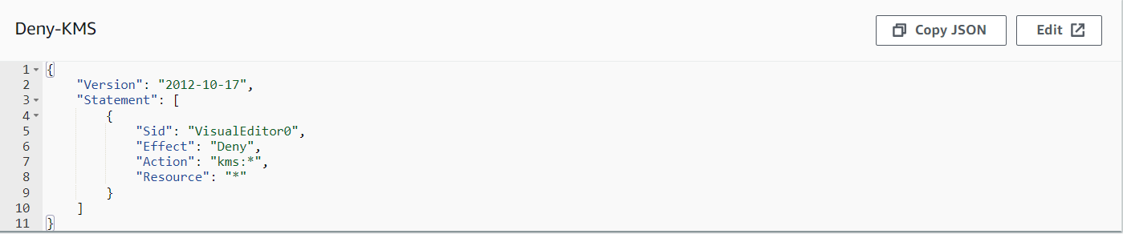
KMS
It is important to ensure that there is no explicit deny added for KMS in the policy associated with the users otherwise Code Commit operations wont work.
Lab: now for the user demouser we have created , create one more deny policy based on JSON.

Slide 12
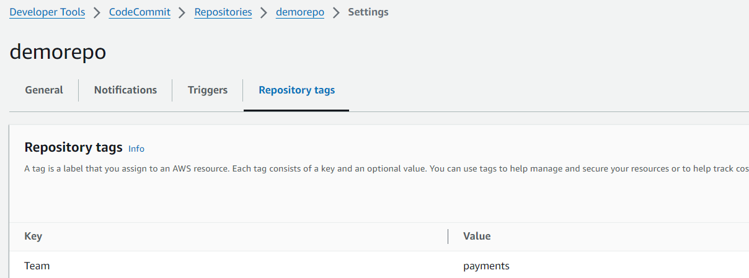
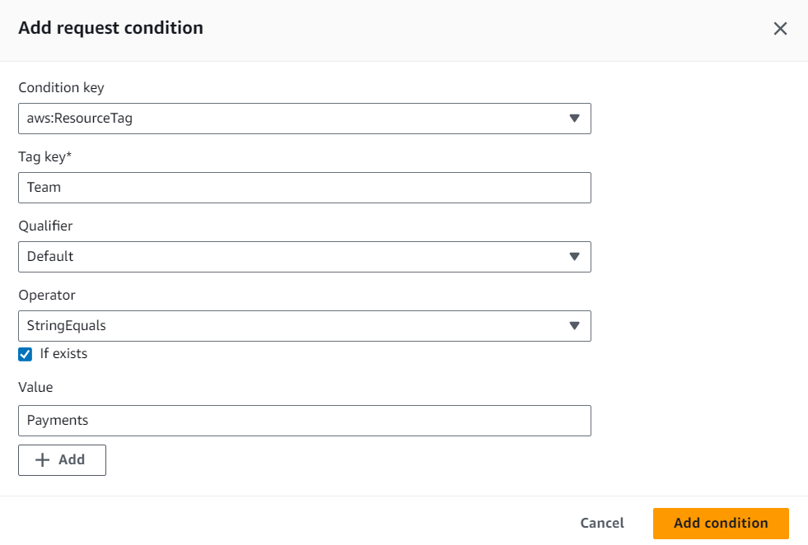
Identity based policy based on tags
Labs: for the demouser remove all the permissions that we attached and also create one more repo called secret-repo.
Next for the demorepo add one tag named Team → payments.
Now we start ahead with the IAM policy.
(That is inline policy ) . Choose the service
Codecommit select (All CodeCommit actions (codecommit:*))
Resources ( ALL) next click ADD another condition.

Slide 13
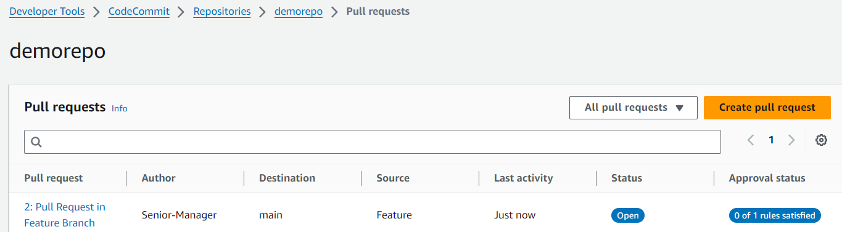
Approval Rule Templates in CodeCommit
In AWS CodeCommit, an approval rule template is a predefined set of criteria that you can apply to a pull request in order to ensure that certain conditions are met before changes can be merged into the main branch. These conditions typically include requiring a certain number of approvals from designated reviewers, ensuring that certain conditions are met (such as passing automated tests or compliance checks), and potentially other custom criteria defined by your team or organization.
When creating or configuring a pull request in CodeCommit, you can select an approval rule template to apply to that pull request. This ensures that the changes undergo the necessary review and meet the defined criteria before they are merged into the main branch, helping maintain code quality, compliance, and security.
Workflow -1 :
When ever a user creates a pull request to the specific branch an approval status would be associated with it .

Slide 14
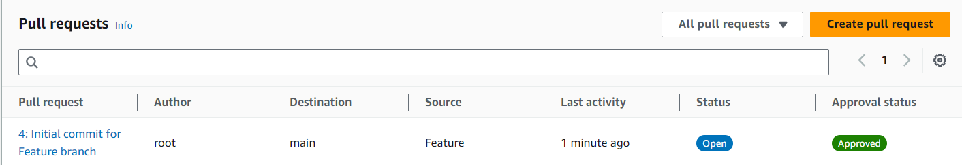
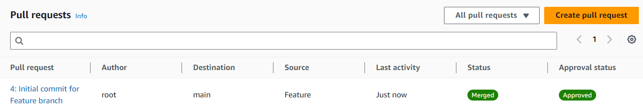
Approval Rule Templates in CodeCommit
Workflow -2 :
Approval pool member can go ahead and review the changes and they can approve it .
Workflow -2 :
The approval status has been changed to Approved .

Slide 15
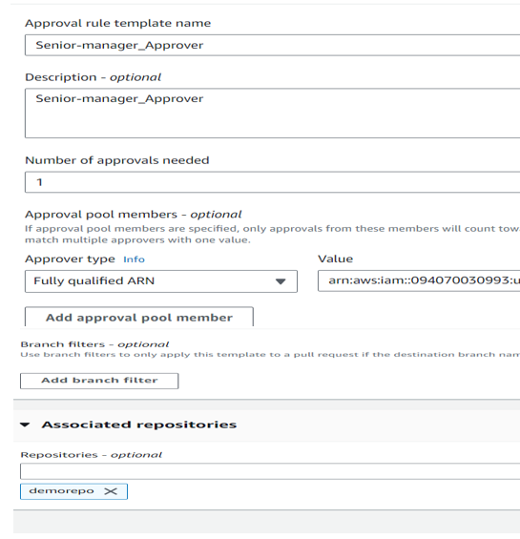
Approval Rule Templates in CodeCommit
Labs : First create a user named Senior-Manager and attach this permission (AWSCodeCommitFullAccess ) . Once the user is created copy its ARN - arn:aws:iam::094070030993:user/Senior-Manager .
Now go to codecommit click Approval rule templates ,

Slide 16
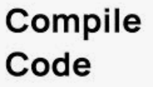
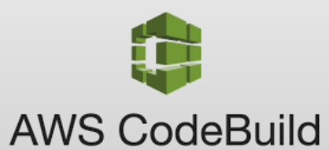
AWS Code build process
In order to understand the build process lets have a look at below build process.
Whenever we write a code in various languages such as java, C and other languages , we need to compile the code first and the O/P of the compilation is in the form of binary that is executable .
#include <stdio.h>
Int main() {
Printf(“Hello!”) compiler C:/EXE
return 0:
}
So AWS Code Build is a fully managed continuous integration service that is used to compile the source code , run tests , and produces software packages that are ready to deploy .
Sample code
AWS code build
Output build

Slide 17
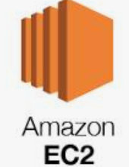
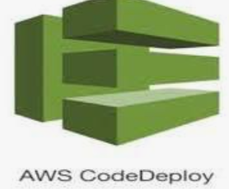
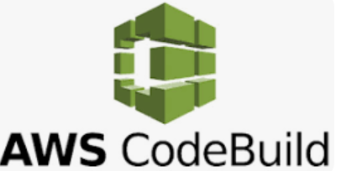



AWS Code deploy process
As we discussed earlier CodeBuild complies the application and uploads the Artifacts to S3 Bucket .
AWS CodeDeploy is a managed service that automates the Software deployments to a verity of compute services such as Amazon EC2 , Fargate , Lambda and others .
So here CodeDeploy will fetch the necessary binary from S3 and it will deploy it to
Various services like AWS EC2 , Lamda , Farget and others .
Compile
Deploy
MyCode

Slide 18
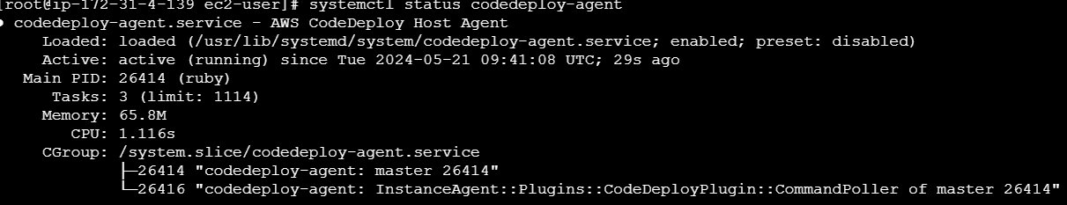
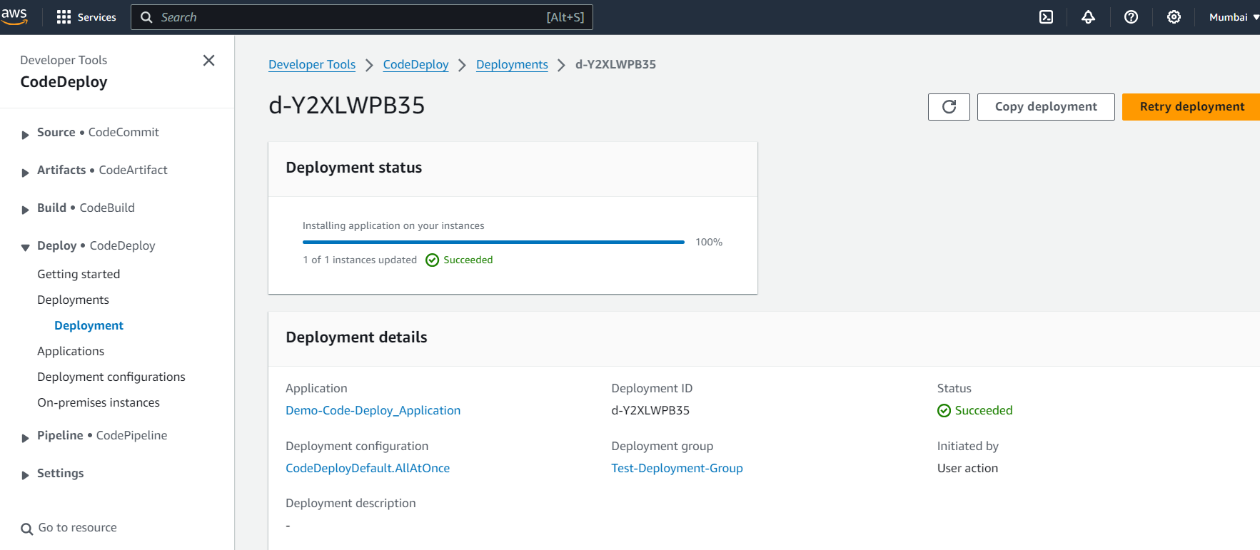
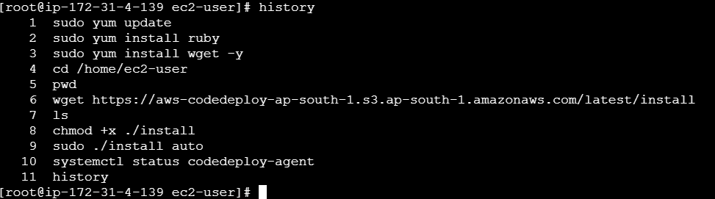
AWS Code deploy Labs
Lab Steps :
Create IAM Role for Code Deploy with S3 Readonly Access . Role name (CodeDeploy-Role) Permissions policies (AmazonS3ReadOnlyAccess , AWSCodeDeployRole)
Create IAM Role for EC2 with S3 Readonly Access . RoleName (EC2-CodeDeploy-Role) Permissions policies (AmazonS3ReadOnlyAccess)
Launch EC2 Instance with Appropriate Role .
Install CodeDeploy Agent in EC2 .
Configure CodeDeploy service .

Slide 19
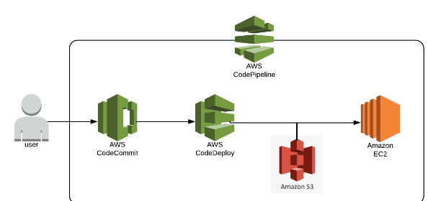
AWS Code pipeline
AWS Code Pipeline is a continuous delivery service to automate steps required to release the software .and it allows us to launch the entire continuous delivery tools mechanism in minutes allowing releasing the code faster.
Code pipeline automatically triggers the pipeline whenever there is a commit in the source repository.

Slide 20
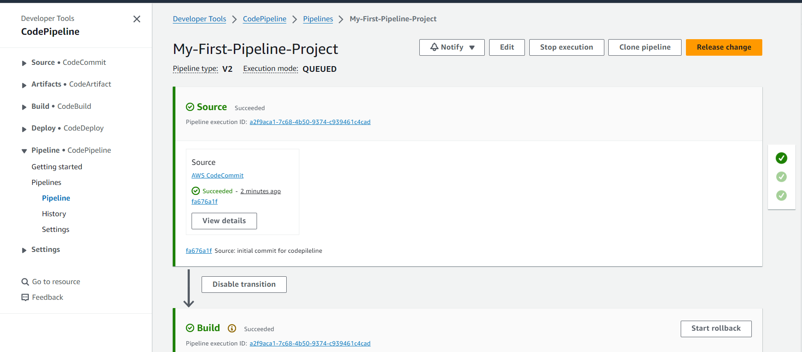
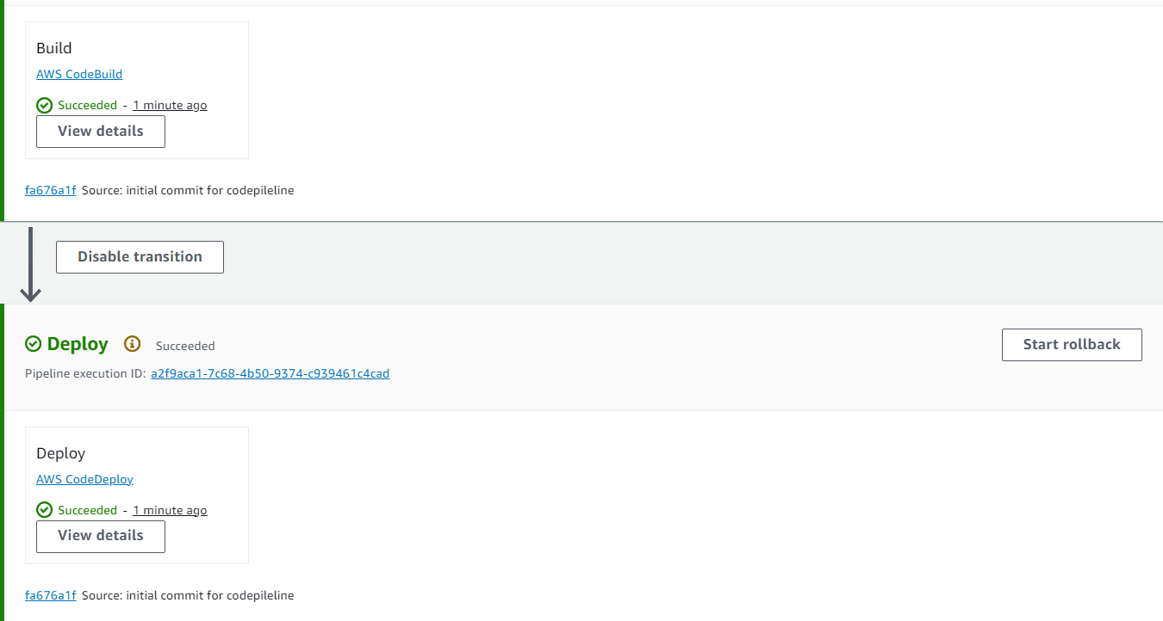
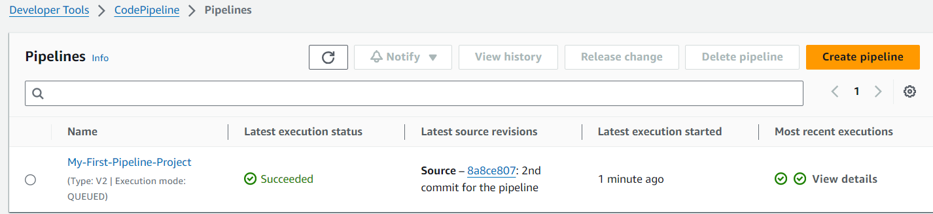
AWS Code pipeline Labs

